Slide 1
Principal Component Analysis (PCA)

Slide 2
Why Reduce Dimensionality?
Reduces time complexity: Less computation
Reduces space complexity: Less parameters
Saves the cost of observing the feature
Simpler models are more robust on small datasets
More interpretable; simpler explanation
Data visualization (structure, groups, outliers, etc) if plotted in 2 or 3 dimensions

Slide 3

Introduction to PCA
Data reduction technique
Developed by Harold Hotelling in 1933
Purpose:
Lower dimensionality
Orthogonality of new dimensions/ transformation/ PCs
finding a mapping from the inputs in the original d-dimensional space to a new (k < d) dimensional space, with minimum loss of information.
The projection of x on the direction of w is

Slide 4
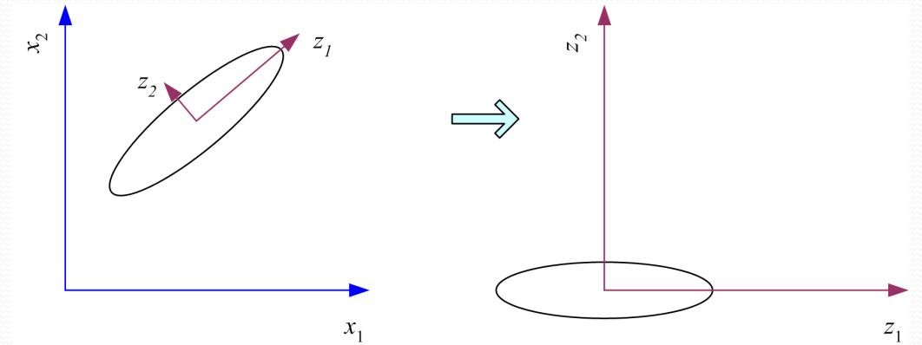
PCA
Principal components analysis centers the sample and then rotates the axes to line up with the directions of highest variance. If the variance on z2 is too small, it can be ignored and we have dimensionality reduction from two to one.
Source: Ethem Alpaydin. 2010. Introduction to Machine Learning (2nd. ed.). The MIT Press.

Slide 5
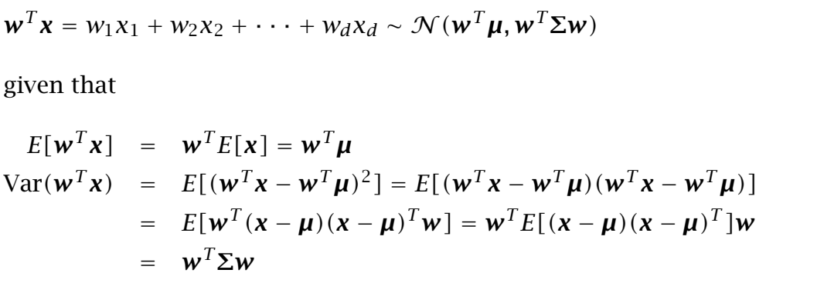
PCA (contd…)

Slide 6
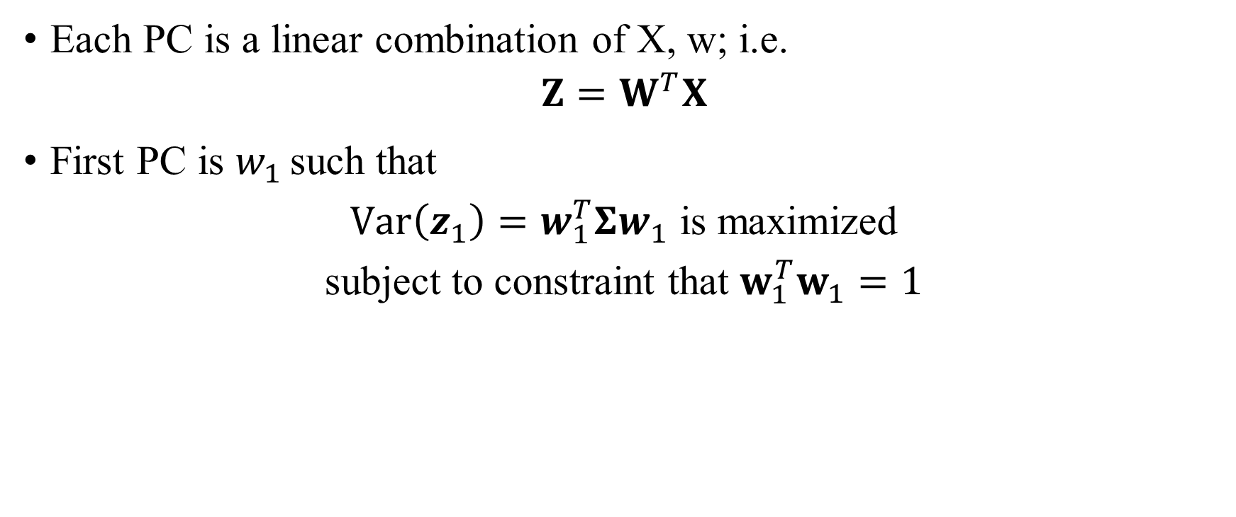

PCA (contd…)

Slide 7
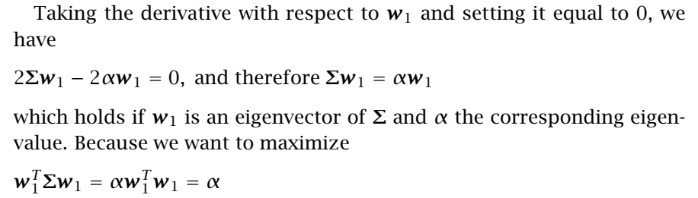
PCA (contd…)
Choose the eigenvector with the largest eigenvalue for the variance to be maximum. Therefore the principal component is the eigenvector of the covariance matrix of the input sample with the largest eigenvalue,
λ1 = α.

Slide 8
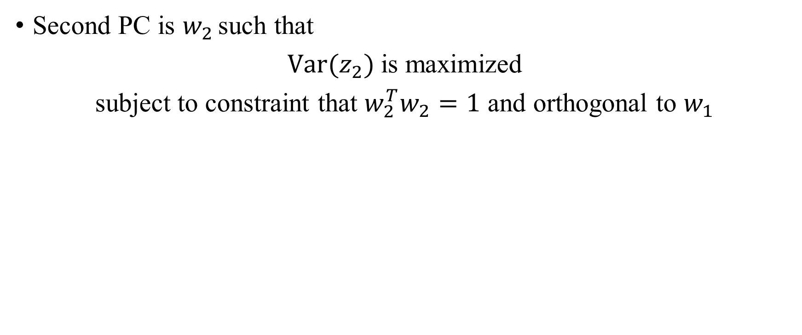

PCA (contd…)

Slide 9
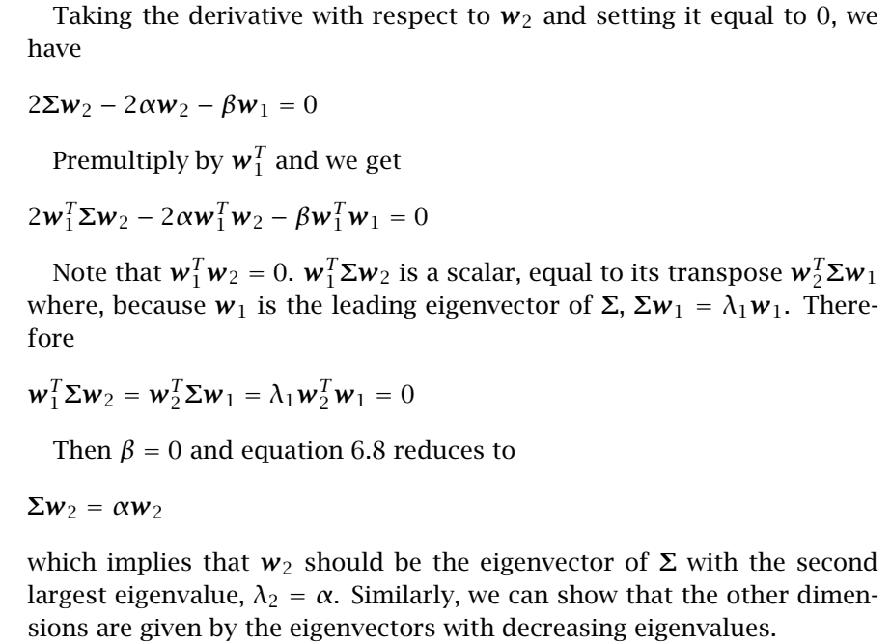
PCA (contd…)

Slide 10
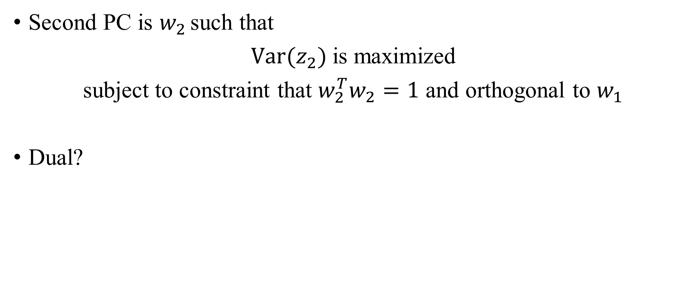
Some Points (contd…)

Slide 11
PCA (contd…)
j^{th} PC ?
Objective function?
Subject to ?

Slide 12

Some Points (contd…)
Choose ‘k’
Proportion of variance (PoV)
Scree Graph
Plot of variance explained as a function of the number of eigenvectors kept
plots of PoV vs k, stop at “elbow”
Ignore the eigenvectors whose eigenvalues are less than the average input variance

Slide 13
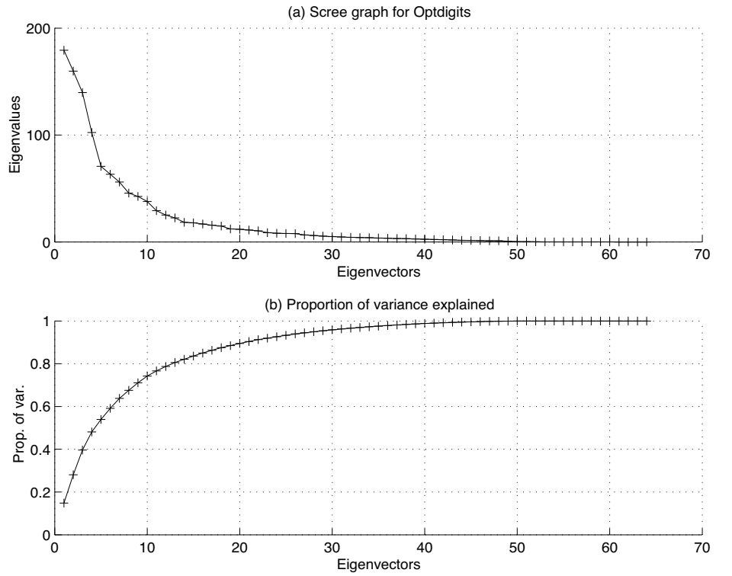
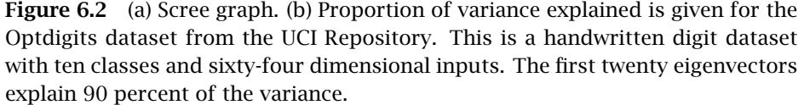
Source: Ethem Alpaydin. 2010. Introduction to Machine Learning (2nd. ed.). The MIT Press.

Slide 14
Principal Component Analysis
Step 1: Standardize the dataset.
Step 2: Calculate the covariance matrix for the features in the dataset.
Step 3: Calculate the eigenvalues and eigenvectors for the covariance matrix. Find unit eigenvector.
Step 4: Sort eigenvalues and their corresponding unit eigenvectors.
Step 5: Pick k eigenvalues and form a matrix of unit eigenvectors.
Step 6: Transform the original matrix.

Slide 15
Principal Component Analysis
Step 1: Standardize the dataset
x₁ = (2, 1), y=0
x₂ = (3, 5), y=0
x₃ = (4, 3), y=0
x₄ = (5, 6), y=1
x₅ = (6, 7), y=1
x₆ = (7, 8), y=1

Slide 16

Principal Component Analysis
Step 2: Calculate the covariance matrix for the features in the dataset.
x₁ = (2, 1), y=0
x₂ = (3, 5), y=0
x₃ = (4, 3), y=0
x₄ = (5, 6), y=1
x₅ = (6, 7), y=1
x₆ = (7, 8), y=1

Slide 17
Principal Component Analysis
Step 3: Calculate the eigenvalues and eigenvectors for the covariance matrix.
Av = λv
(A – λI)v = 0,
Here, v is known as the eigenvector belonging to each eigenvalue (λ)

Slide 18
Principal Component Analysis
Step 4: Sort eigenvalues and their corresponding eigenvectors. Find unit eigenvector.
(A – λI)v = 0,

Slide 19
Principal Component Analysis
Step 5: Pick k eigenvalues and form a matrix of eigenvectors.

Slide 20
Principal Component Analysis
Step 6: Transform the original matrix.

Slide 21


















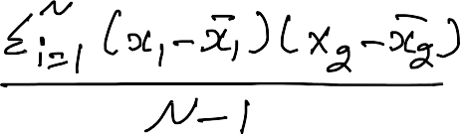



























Slide 22


































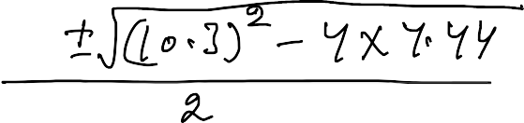







Slide 23




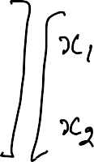






























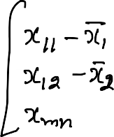









Slide 24














Slide 25
Principal Component Analysis
Is PCA good for classification problems?
NO

Slide 26
References
Ethem Alpaydin. 2010. Introduction to Machine Learning (2nd. ed.). The MIT Press.

Slide 27
1) Dimensionality Reduction: PCA
Principal components analysis (also called the Karhunen-Loeve, or K-L method) searches for k n-dimensional orthogonal vectors that can best be used to represent the data, where k ≤ n.
Find a projection that captures the largest amount of variation in data
The original data are projected onto a much smaller space, resulting in dimensionality reduction. We find the eigenvectors of the covariance matrix, and these eigenvectors define the new space
x₂
e
x₁

Slide 28
1) Dimensionality Reduction: PCA
The original data are thus projected onto a much smaller space, resulting in dimensionality reduction.
Normalize input data: Each attribute falls within the same range.
Compute k orthonormal (unit) vectors, i.e., principal components.
Each input data (vector) is a linear combination of the k principal component vectors.
The principal components are sorted in order of decreasing “significance” or strength.
Since the components are sorted, the size of the data can be reduced by eliminating the weak components, i.e., those with low variance (i.e., using the strongest principal components, it is possible to reconstruct a good approximation of the original data)
Works for numeric data only

Slide 29
1) Dimensionality Reduction: PCA
Steps for PCA:
Step 1: Standardization (or Data normalization):
PCA normalized the input data, so that each attribute falls within the same range.
Normalization helps ensure that attributes with large domains will not dominate attributes with smaller domains.
Calculate mean.

Slide 30
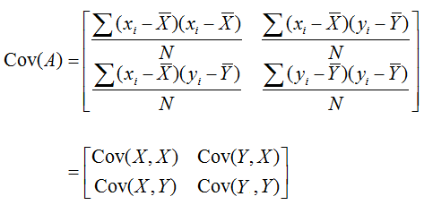
1) Dimensionality Reduction: PCA
Steps for PCA:
Step 2: Covariance matrix (Find Covariance Matrix to identify correlation):
This step calculates the covariance matrix of the standardized data.
Covariance matrix shows how each variable is related to every other variable in the dataset.
If the value of the Covariance Matrix is positive, then it indicates that the variables are correlated. (If X increases, Y also increases and vice versa)
If the value of the Covariance Matrix is negative, then it indicates that the variables are inversely correlated. (If X increases, Y also decreases and vice versa).
If the value of the Covariance Matrix is zero, then the variables are no correlated.

Slide 31
1) Dimensionality Reduction: PCA
Step 3: Calculate eigen value of the Covariance matrix:
Characteristic equation is used to find eigen values.
det(A- λI) = 0
where I is the identity matrix and det(B) is the determinant of the matrix B.
From the determinant of the matrix, we can find Quadratic equation and can find the λ.
The solutions λ of the characteristic equation are the eigenvalues.
An eigenvalue is a number representing the amount of variance present in the data for a given direction.
N by N matrix has N eigen values.

Slide 32
1) Dimensionality Reduction: PCA
Step 4: Find eigen vectors of the Covariance matrix:
[A- λI]X = 0 or AX= λX
The eigenvectors represent the directions in which the data varies the most, while the eigenvalues represent the amount of variation along each eigenvector.
Each eigenvector has its corresponding eigenvalue.

Slide 33
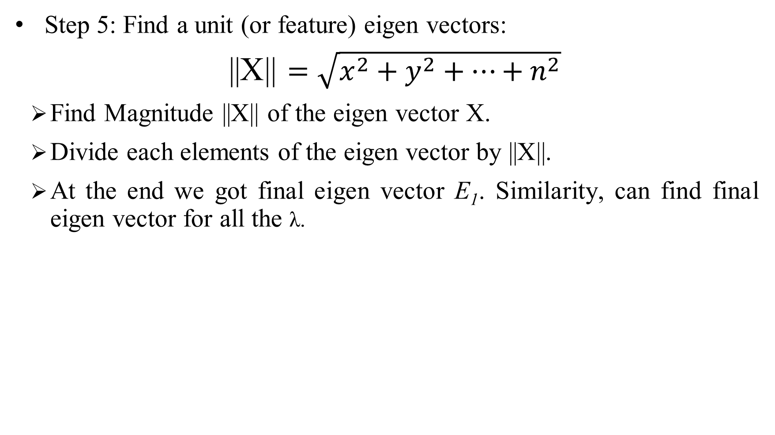
1) Dimensionality Reduction: PCA
Step 5: Find a unit (or feature) eigen vectors:
||X|| $=\sqrt{x^{2}+y^{2}+…+n^{2}}$
Find Magnitude ||X|| of the eigen vector X.
Divide each elements of the eigen vector by ||X||.
At the end we got final eigen vector E₁. Similarity, can find final eigen vector for all the λ.

Slide 34
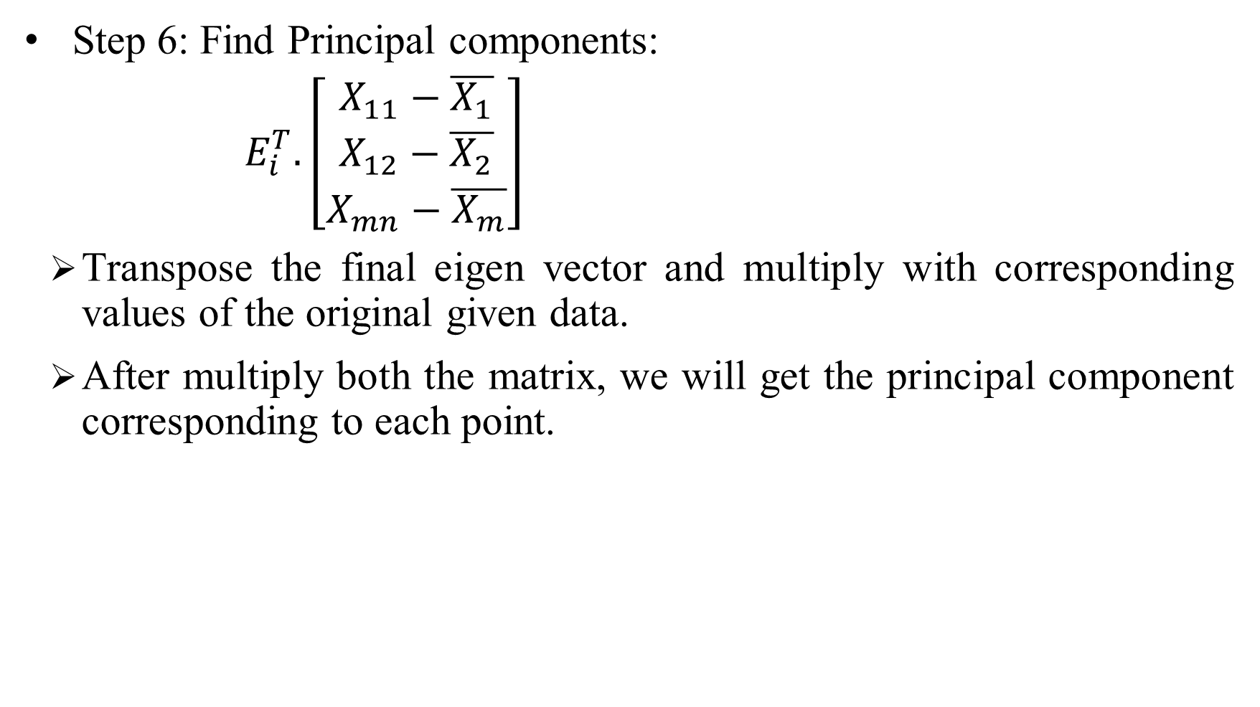
1) Dimensionality Reduction: PCA
Step 6: Find Principal components:
$E_{i}^{T}.\left[\begin{aligned}\begin{aligned}X_{11}−\overline{X_{1}} \\ X_{12}−\overline{X_{2}}\end{aligned} \\ X_{mn}−\overline{X_{m}}\end{aligned}\right]$
Transpose the final eigen vector and multiply with corresponding values of the original given data.
After multiply both the matrix, we will get the principal component corresponding to each point.

Slide 35
1) Dimensionality Reduction: PCA
Step 7: Transform the data (Visualization):
The final step is to transform the original data into the lower-dimensional space defined by the principal components.
The transformation does not modify the original data itself but instead provides a new perspective to better represent the data.

Slide 36

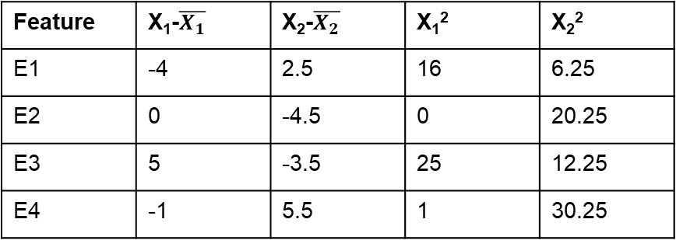


1) Dimensionality Reduction: PCA
Example1:
Step 1: Standardization (or Data normalization):
Calculate mean
$$\overline{X_{1}}=8,$$
$$\overline{X_{2}}=8.5$$
Step 2: Find Covariance matrix:
Feature | X₁ | X₂
E1 | 4 | 11
E2 | 8 | 4
E3 | 13 | 5
E4 | 7 | 14
Feature | X₁-$\overline{X_{1}}$ | X₂-$\overline{X_{2}}$ | X₁² | X₂²
E1 | -4 | 2.5 | 16 | 6.25
E2 | 0 | -4.5 | 0 | 20.25
E3 | 5 | -3.5 | 25 | 12.25
E4 | -1 | 5.5 | 1 | 30.25
(X₁ -$\overline{X_{1} }$)²/n-1(n is 4 here)=14
((X₁ -$\overline{X_{1} }$) * (X₂ -$\overline{X_{2} }$) )/n-1=-11
(X₂ -$\overline{X_{1} }$)²/n-1=23
$$\left[\begin{aligned}\begin{aligned}14 −11\end{aligned} \\ −11 23\end{aligned}\right]$$

Slide 37
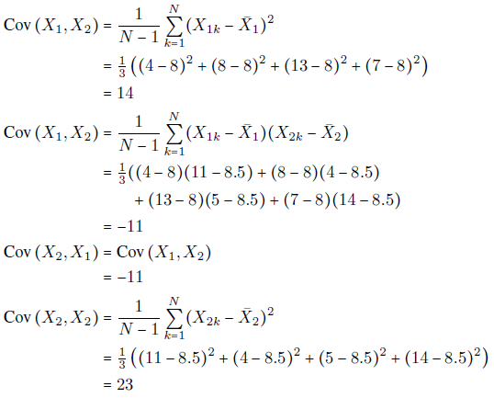

Slide 38
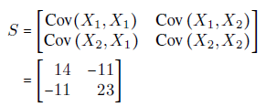
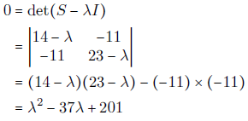

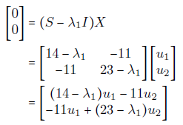

Slide 39

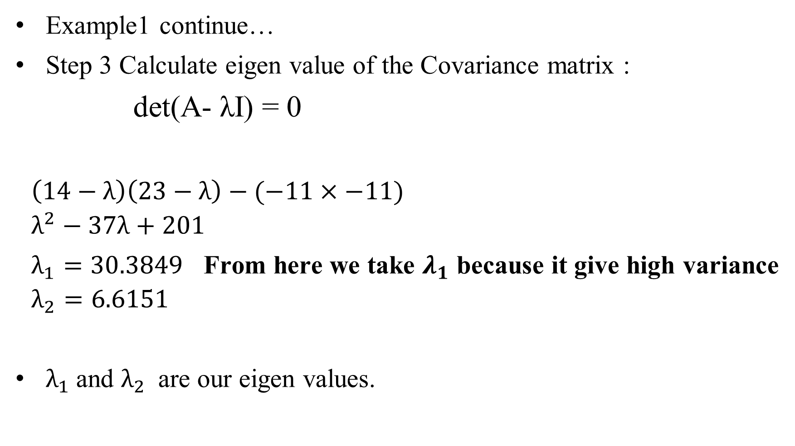
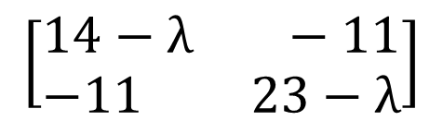
1) Dimensionality Reduction: PCA
Example1 continue…
Step 3 Calculate eigen value of the Covariance matrix :
det(A- λI) = 0
$$\left(14−λ\right)\left(23−λ\right)−(−11×−11)$$
$$λ^{2}−37λ+201$$
$λ_{1}=30.3849$ From here we take $λ_{1}$ because it give high variance
$$λ_{2}=6.6151$$
$λ_{1}$and $λ_{2}$ are our eigen values.
$$\left[\begin{aligned}\begin{aligned}14 −11\end{aligned} \\ −11 23\end{aligned}\right]$$
$$\left[\begin{aligned}\begin{aligned}14−λ −11\end{aligned} \\ −11 23−λ\end{aligned}\right]$$

Slide 40
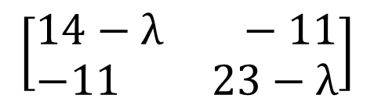
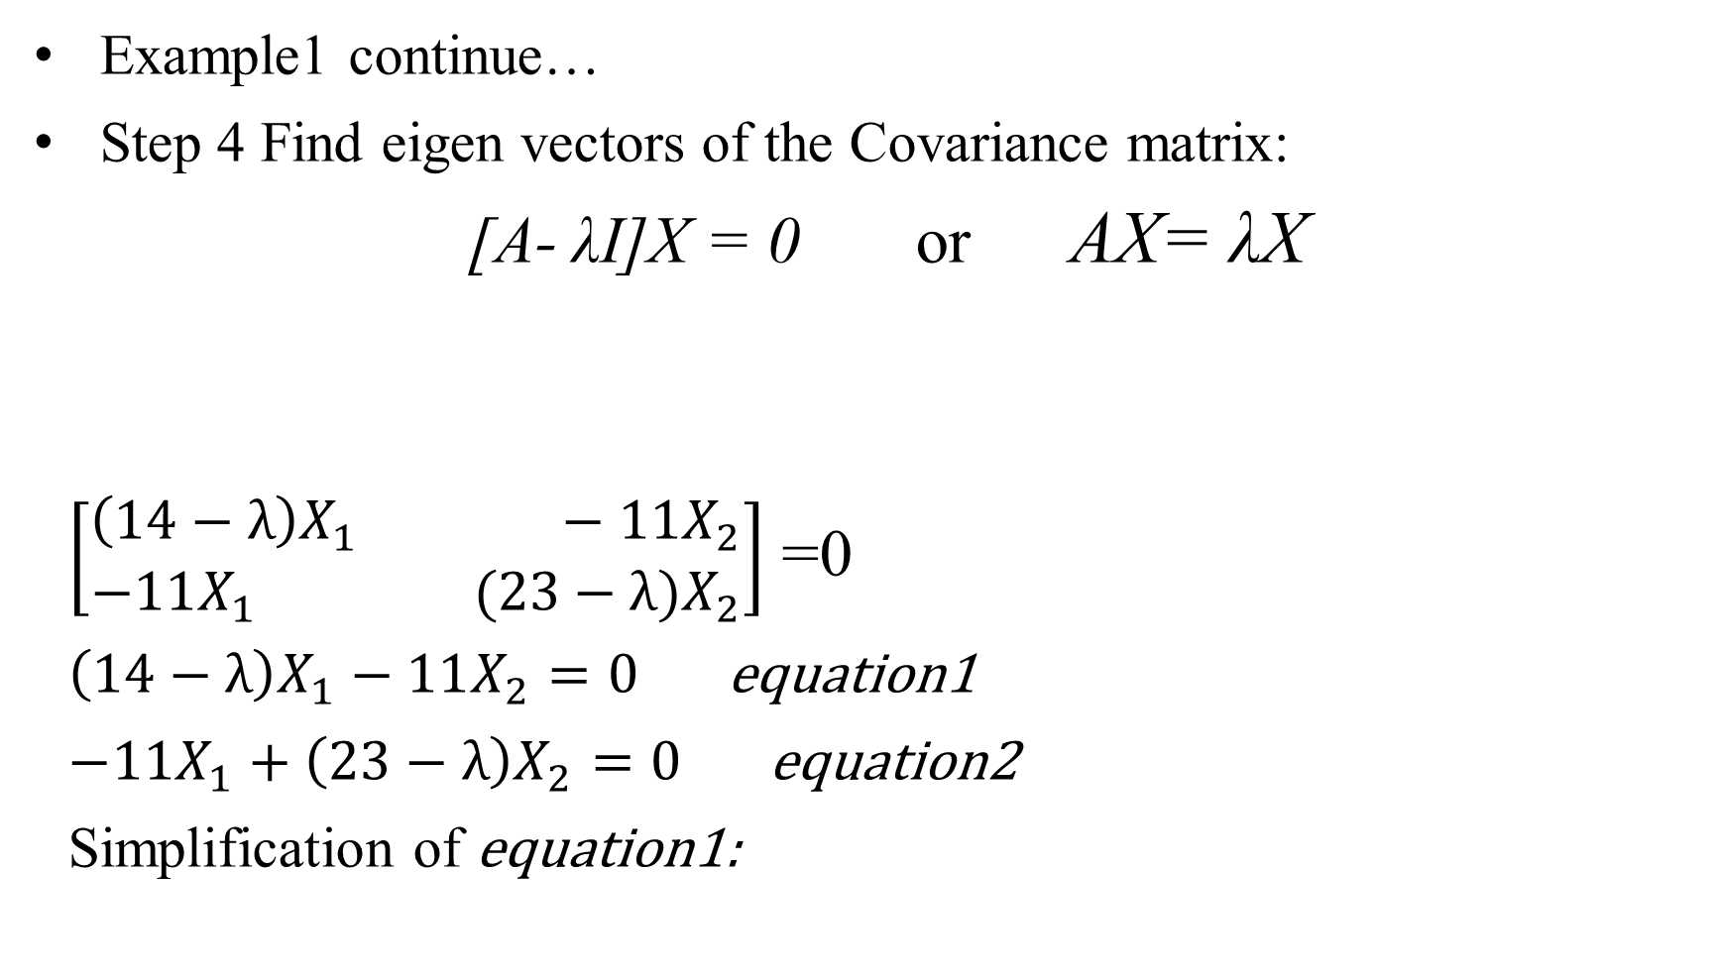
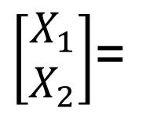

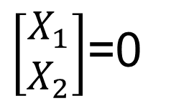
1) Dimensionality Reduction: PCA
Example1 continue…
Step 4 Find eigen vectors of the Covariance matrix:
[A- λI]X = 0 or AX= λX
$\left[\begin{aligned}\begin{aligned}\left(14−λ\right)X_{1} −11X_{2}\end{aligned} \\ −11X_{1} (23−λ)X_{2}\end{aligned}\right]$ =0
$\left(14−λ\right)X_{1}−11X_{2}=0$ equation1
$−11X_{1}+\left(23−λ\right)X_{2}=0$ equation2
Simplification of equation1:
$$\left[\begin{aligned}\begin{aligned}14−λ −11\end{aligned} \\ −11 23−λ\end{aligned}\right]$$
$\left[\begin{aligned}X_{1} \\ X_{2}\end{aligned}\right]$=0
$\left[\begin{aligned}X_{1} \\ X_{2}\end{aligned}\right]$=
$$\left[\begin{aligned}\begin{aligned}11\end{aligned} \\ 14−λ\end{aligned}\right]$$

Slide 41
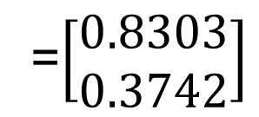



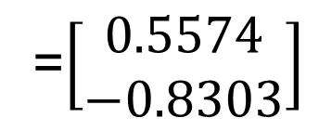

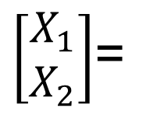

1) Dimensionality Reduction: PCA
$\left[\begin{aligned}X_{1} \\ X_{2}\end{aligned}\right]$=
$$\left[\begin{aligned}\begin{aligned}11\end{aligned} \\ 14−λ\end{aligned}\right]$$
Example1 continue…
Step 5: Find a unit (or feature) eigen vectors:
||X|| $=\sqrt{x^{2}+y^{2}+…+n^{2}}$
= $\sqrt{{11}^{2}+{(14−λ_{1})}^{2}}$
=19.7348
Here we take E₁ because we
Take $λ_{1}$ value here
$$E_{1}=\left[\begin{aligned}{11}/{19.7348} \\ {(14−λ_{1})}/{19.7348}\end{aligned}\right]$$
=$\left[\begin{aligned}0.5574 \\ −0.8303\end{aligned}\right]$
$$E_{2}=\left[\begin{aligned}{11}/{19.7348} \\ {(14−λ_{2})}/{19.7348}\end{aligned}\right]$$
=$\left[\begin{aligned}0.8303 \\ 0.3742\end{aligned}\right]$

Slide 42




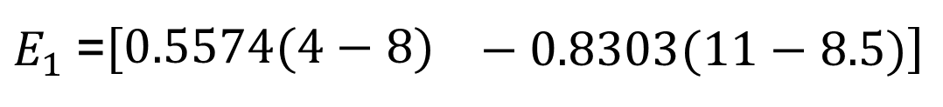
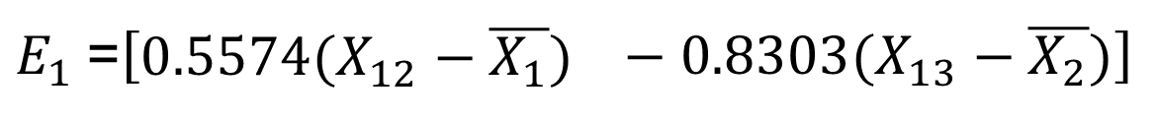
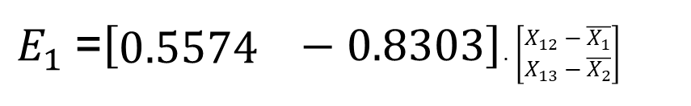

1) Dimensionality Reduction: PCA
Example1 continue…
Step 6: Find Principal components:
$E_{1}^{T}.\left[\begin{aligned}\begin{aligned}X_{12}−\overline{X_{1}} \\ X_{13}−\overline{X_{2}}\end{aligned}\end{aligned}\right]$
Feature | X₁ | X₂
E1 | 4 | 11
E2 | 8 | 4
E3 | 13 | 5
E4 | 7 | 14
$$−4.3053$$
3.73630
5.69305
-5.12405
$E_{1}$=$\left[\begin{aligned}0.5574\end{aligned} −0.8303\right]$. $\left[\begin{aligned}\begin{aligned}X_{12}−\overline{X_{1}} \\ X_{13}−\overline{X_{2}}\end{aligned}\end{aligned}\right]$
$$\overline{X_{1}}=8,$$
$$\overline{X_{2}}=8.5$$
$E_{1}$=$\left[\begin{aligned}0.5574(X_{12}−\overline{X_{1}})\end{aligned} −0.8303(X_{13}−\overline{X_{2}})\right]$
$E_{1}$=$\left[\begin{aligned}0.5574(4−8)\end{aligned} −0.8303(11−8.5)\right]$
$$=−4.3053$$
$E_{1}$=$\left[\begin{aligned}0.5574 \\ −0.8303\end{aligned}\right]$

Slide 43
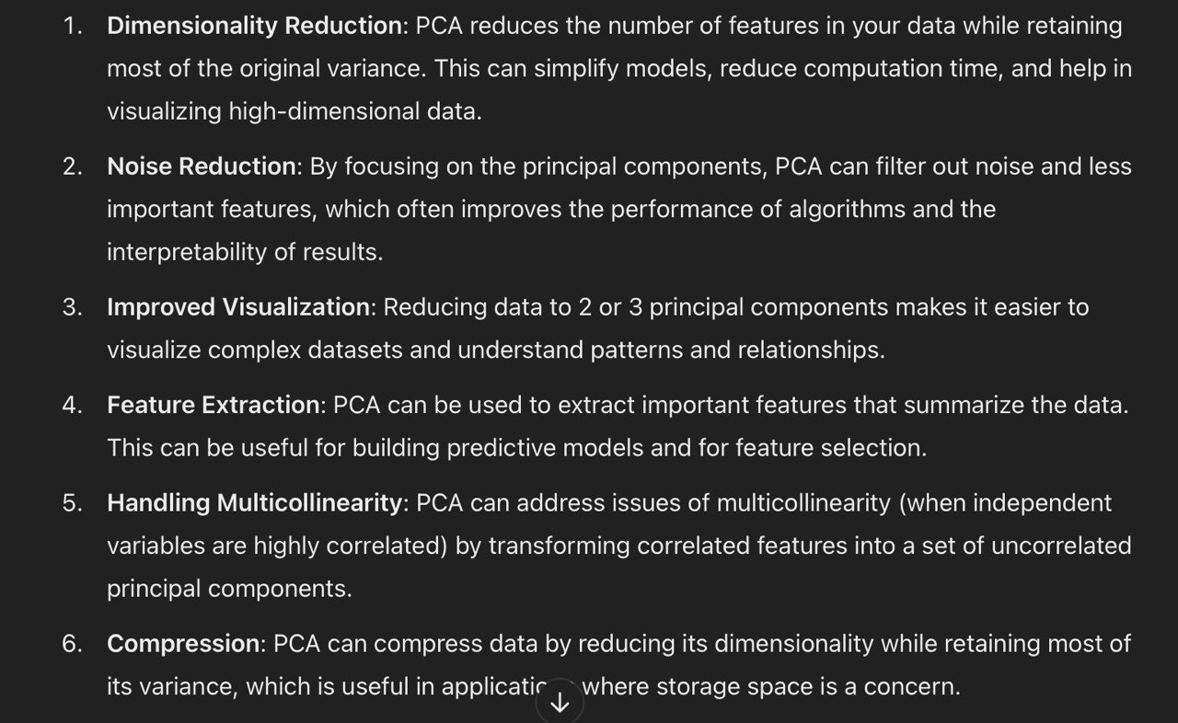

Slide 44
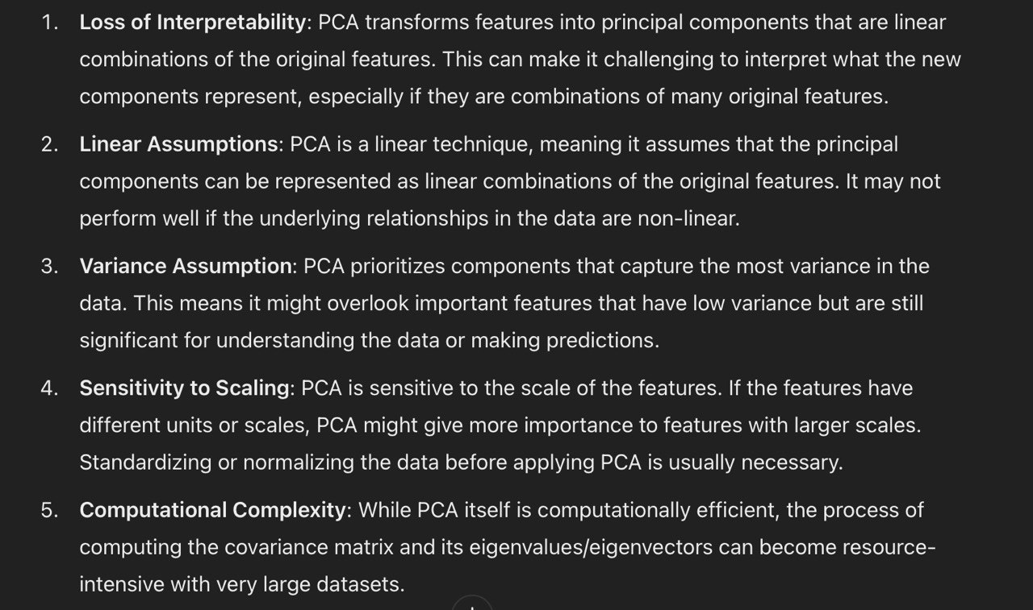

Slide 45
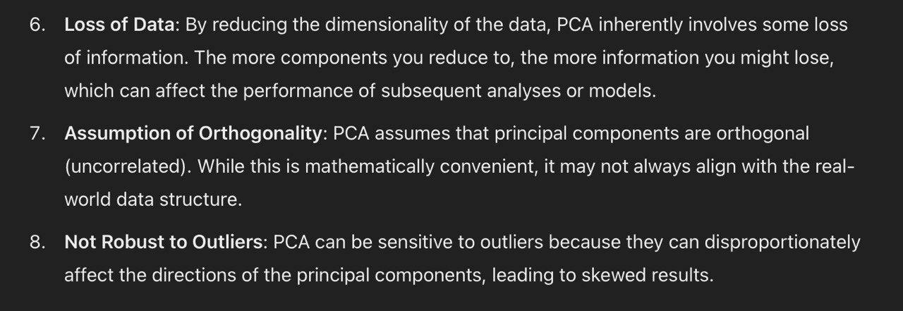

Slide 46
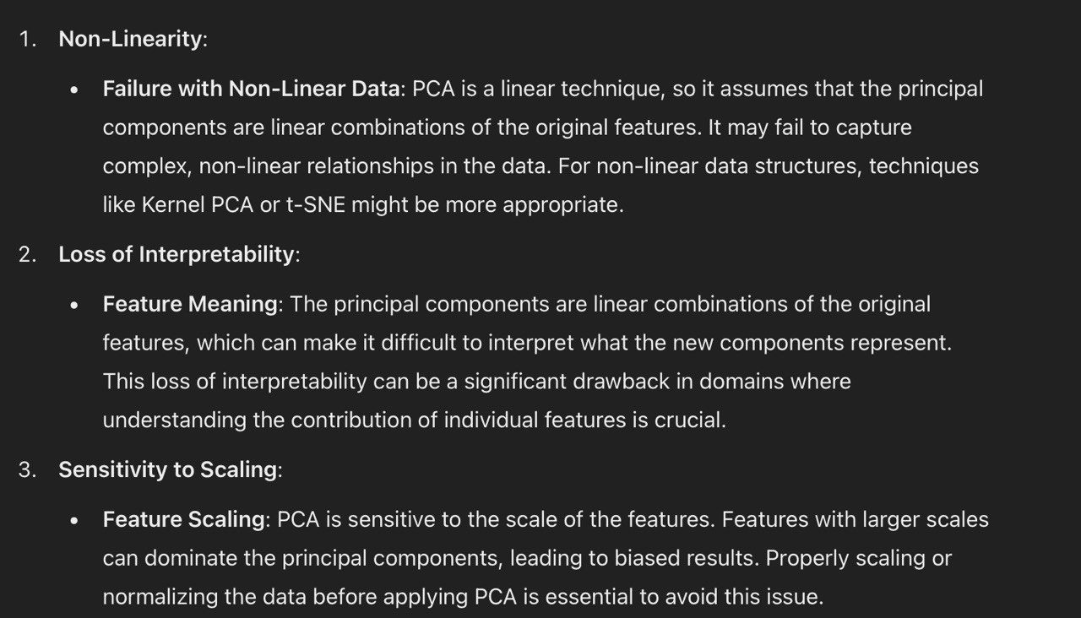

Slide 47


Slide 48


Slide 49


Slide 50


